Slide 1
Welcome!
University Regional Conference Meeting #5
February 21, 2025 Emmett Hull- VP of Student Development Kathy Gamboa - IISE Membership Director

Slide 2
Agenda
Capture Your Conference – Magazine Visibility
Completed Conferences - Lessons Learned
Sarah-Eve Fontaine- Universite
Derek Hoffman and Elliott Frank
University of South Florida Website
Due Dates
Contact List
Conference Welcome Message
Technical Paper Competition
Regional Business Meeting
Around the Room
Wrap-Up/Questions

Slide 3
Capture your Conference
Designate someone to take pictures, post them on social media and tag IISE. Please also send them to Kgamboa@iise.org. Pictures from Student conferences will be in upcoming ISE magazines, do you want to be in print?

Slide 4
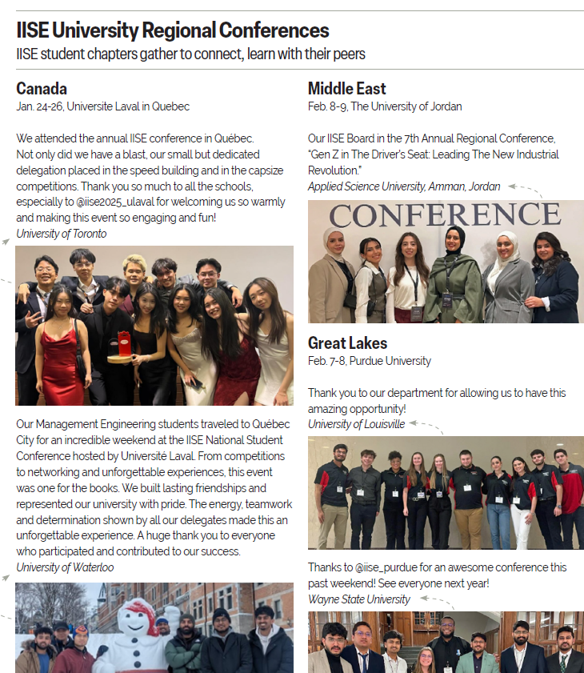
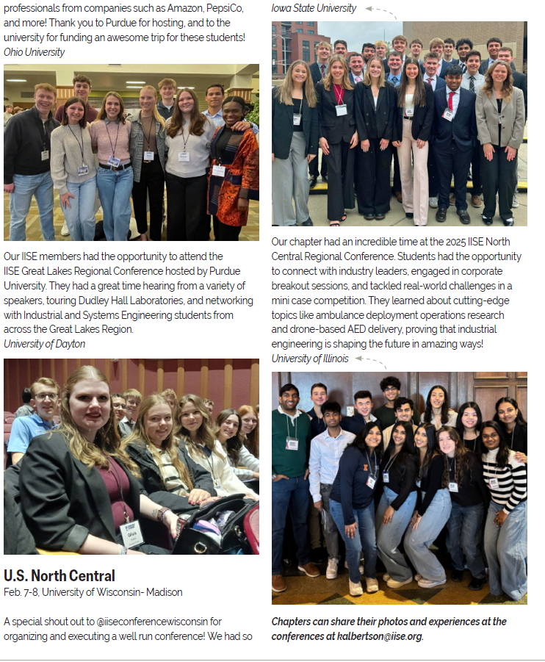
Keith Albertson– Magazine Visibility (KAlbertson@iise.org)

Slide 5
Completed Conferences – Lessons Learned
Canada Dates: January 24-26, 2025 Location: Universite Laval in Quebec Contact: Sarah-Eve Fontaine, Student Chair Contact: Nadia Lehoux, Faculty Conference Chair
Middle East Date: Feb.8-9, 2025 Location: The University of Jordan Contact: Haya Masri, Student Conference Chair Contact: Mohannad Jreissat, Faculty Conference Chair U.S. North Central Dates: February 7-8, 2025 Location: University of Wisconsin- Madison Contact: Elliott Frank, Derek Hoffman Student Chairs Contact: Dharmaraj Veeramani , Faculty Conference Chair
U.S. Great Lakes Dates: Feb. 7-8, 2025 Location: Purdue University - West Lafayette Contact: Mihika Sane or Rhea Bawa, Student Conference Chair Contact: Barrett Caldwell, Faculty Conference Chair

Slide 6
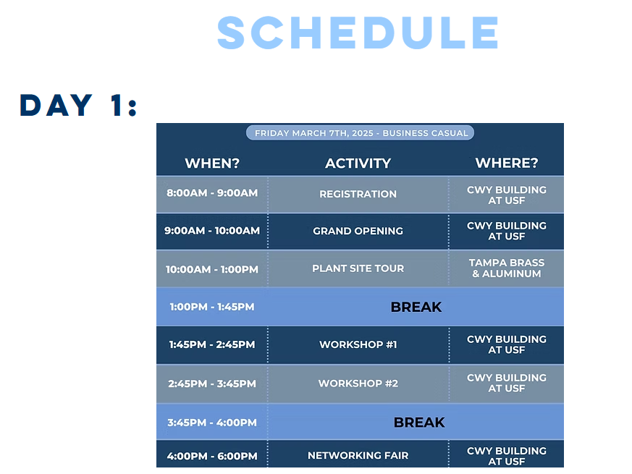
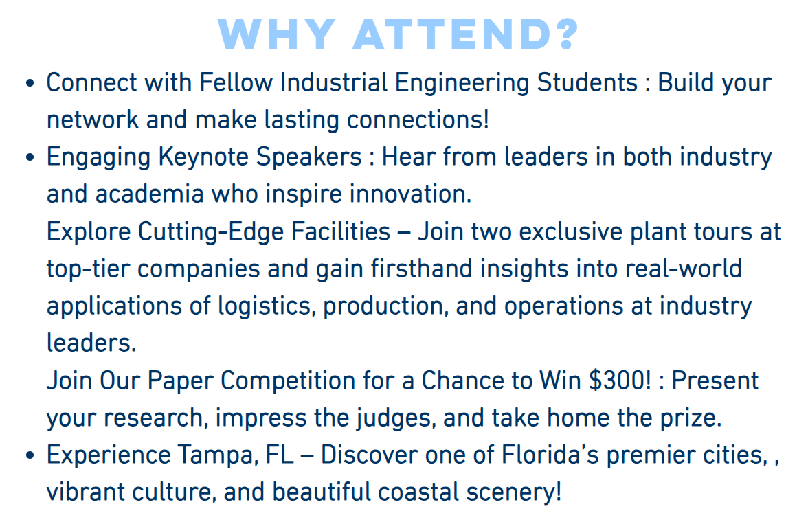
Conference Web Pages –University of South Florida
Southeast Region

Slide 7
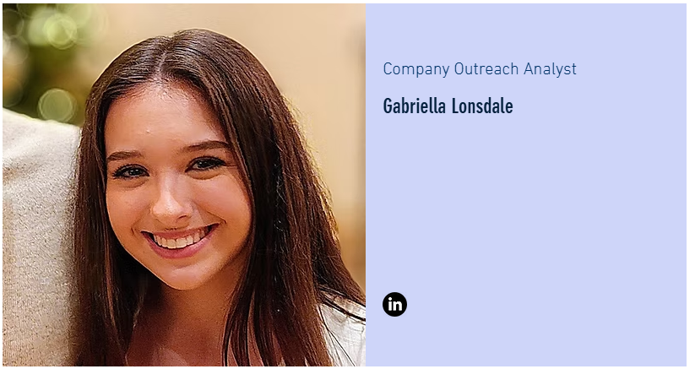
Conference Web Pages –University of South Florida
Southeast Region

Slide 8
One week after the conference – To Do
The final report 2025 Final Report Template of the conference should be sent to
Kathy Gamboa, with the first, second and third place winners of the technical
paper competition-region level, along with next year's host chapter no more
than one week after the conference.
The final report should include:
A copy of the package distributed at the time of registration.
A summary of conference activities.
Names, schools, and titles of the technical paper award winners.
A list of attendees by schools in an Excel spreadsheet.
Please include at least names and email addresses.
Suggestions for future conference programs.
The name of the host school for next two years
(or updated rotational schedule, if one has been established).
https://www.iise.org/details.aspx?id=863

Slide 9
Checklist and Timeline – Start Now – ( In progress )
5 months before _____ Write and send letters for sponsors (include all senior chapters) _____ Write and send letters to invite speakers _____ Write letters to faculty advisors requesting their help in recruiting submissions for the technical paper competition _____ Receive and monitor sponsorship funds
4 months before _____ Follow up sponsor and speaker invites with personal phone calls and e-mails _____ Confirm first invitees (speakers) _____ Design, print, and mail registration packet including a more detailed program, registration forms, directions, and accommodation information _____ Sell ads to local businesses _____ Update Web site
3 months before _____ Monitor responses of universities. Contact student chapter presidents and faculty advisors as needed _____ Invite backup speakers _____ Finalize budget (based on donations)
2 months before _____ Conduct sign-up for workers and begin schedule _____ Finalize speaker lineup and complete agenda _____ Arrange all food (conference, coffee breaks, luncheon, and brunch) _____ Monitor responses to technical paper competition and react accordingly
1 month before _____ Final pre-registration deadline _____ Finish format of program and take to printer _____ Order souvenirs for students to purchase (t-shirts, plastic cups, coffee mugs, etc.)
2 weeks before _____ Create welcome package (assemble packet materials and name tags) _____ Map out welcome/check in process _____ Confirmation calls to all speakers, facilities, and catering _____ Last minute speaker arrangements and logistics

Slide 10
Required Reports and Deadlines
There are three reports required from the host chapter:
#1 The preliminary agenda and preliminary budget. Due Oct. 15. Sample agenda | Sample budget #2 The final agenda and final budget is due two weeks before your conference.
#3 The final report is due two weeks after your conference, with the exception of the first, second and third place winners of the technical paper competition-region level within two days. Please send to Kathy Gamboa. Very important: Please include the school, host chapter, student chair, faculty advisor and the date for next year's university region conference.

Slide 11
Final Report and Final Agenda Due Dates –
Canada Dates: January 24-26, 2025 Report Due DATE: January 9, 2025 Central & South America Dates: Aug. 19-20, 2025 Report Due DATE: September 11, 2025
Mexico Dates: March 11-14, 2025 Report Due DATE: February 24, 2025
U.S. Mid-Atlantic Dates: Feb. 21-23, 2025 Report Due DATE: February 6, 2025
U.S. North Central Dates: February 7-8, 2025 Report Due DATE: January 23, 2025
U.S. Northeast Dates: March 28-30, 2025 Report Due DATE: March 13, 2025
U.S. South Central Dates: Feb. 20-22, 2025 Report Due DATE: February 5, 2025
U.S. Southeast Dates: March 7-8, 2025 Report Due DATE: February 20, 2025 U.S. Western Dates: Feb.28 - March 2, 2025 Report Due DATE: February 13, 2025
Middle East
Date: Feb.8-9, 2025 Report Due DATE: January 30, 2025
U.S. Great Lakes Dates: Feb. 7-8, 2025 Report Due DATE: January 23, 2025
NOTE: Final Reports are due

Slide 12
Post Conference Report Due Dates –
Two days after the conference: The first, second and third place winners, school and an electronic version of their papers must be submitted to Kathy Gamboa.
Two weeks after the conference: The final report Final Summary Report of the conference should be sent to Kathy Gamboa, with the first, second and third place winners of the technical paper competition-region level, along with next year's host chapter no more than one week after the conference. The final report should include:
The Final Report
Names, schools, and titles of the technical paper award winners.
A list of attendees by schools in an Excel spreadsheet. Please include at least names and email addresses.
Suggestions for future conference programs.
The name of the host school for next two years (or updated rotational schedule, if one has been established).

Slide 13
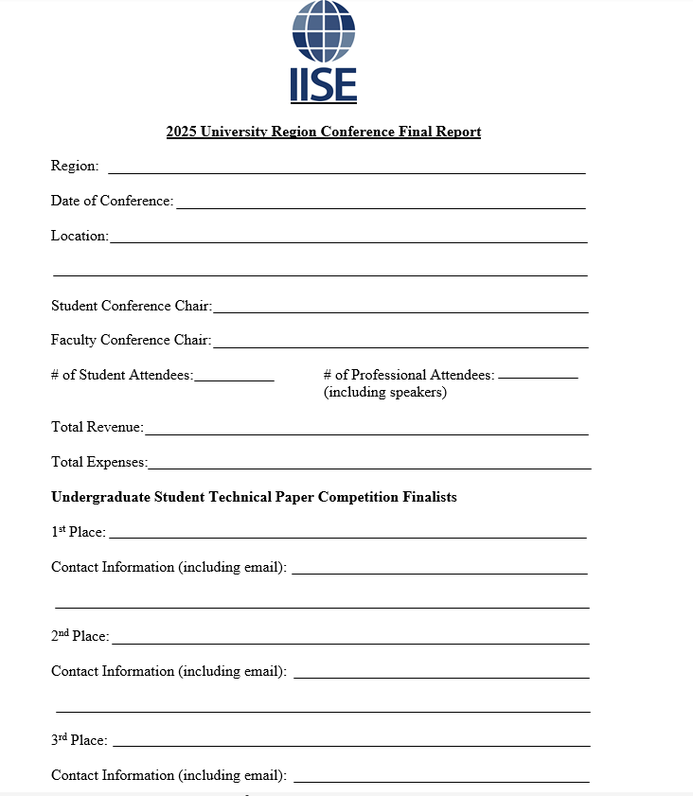
Post Conference Final Report
Page 1

Slide 14
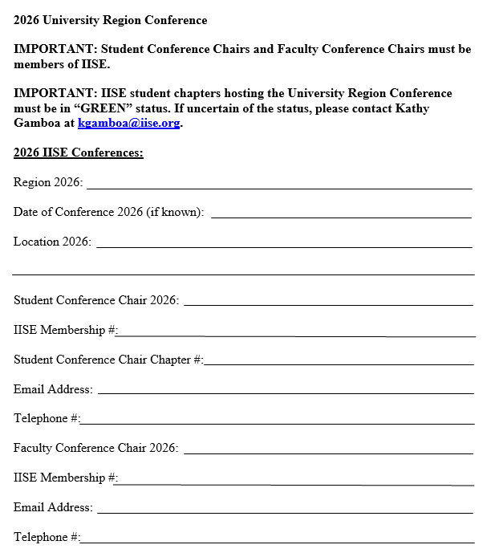
Post Conference Final Report
Page 2

Slide 15
Contact Lists
If you requested a contact list of your Region Chapter Presidents and Faculty Advisors it has been sent to you by from Amy Straub Astraub@iise.org. Email her if you are still in need of the list.
Let her know if you need any additional information.
Notes:
https://app.smartsheet.com/b/form/7fda106ac3a349eeb33f0cac2e32855d

Slide 16
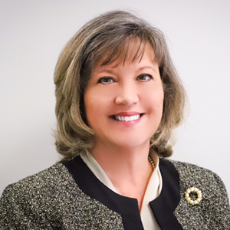
Conference Welcome
The current President of IISE, Victoria Jordan, has recorded a welcome message for your student conference attendees.
Here’s the link: https://youtu.be/z_iQ5SaJaW4
We are asking each RVP to attend the Student Regional Conference in their Region or to send a delegate. Schedules permitting, they will present a brief overview of IISE.
You should have confirmation from them prior to your conference.

Slide 17
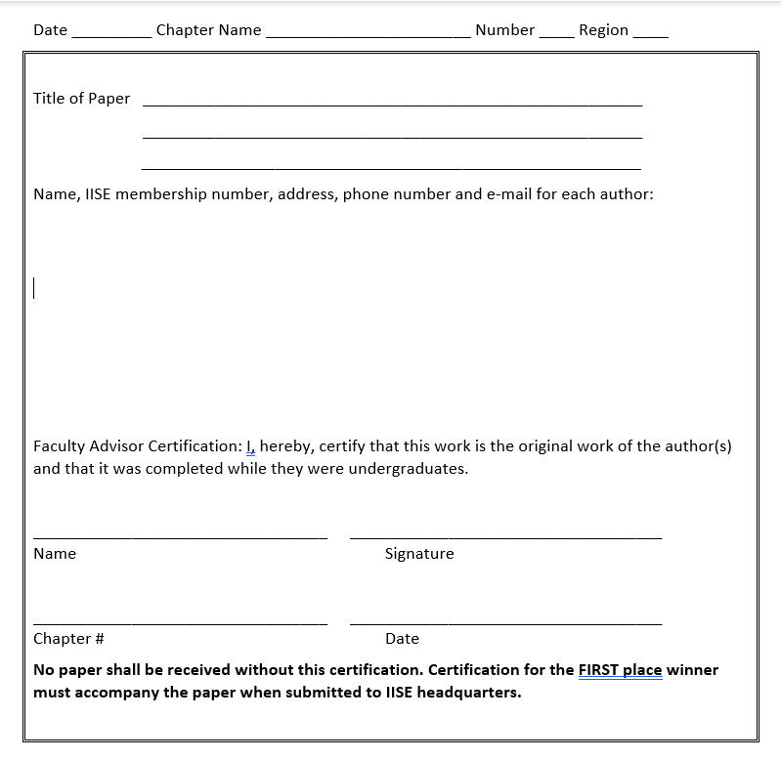
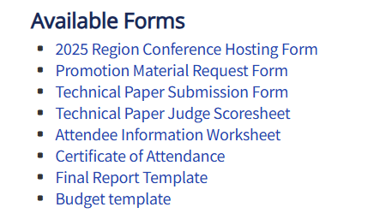
Technical Paper Competition Form
This form validates that Students were the primary contributors of the project. Required for submission.
All forms can be found here: https://www.iise.org/Details/?id=814
Notes:
https://app.smartsheet.com/b/form/7fda106ac3a349eeb33f0cac2e32855d

Slide 18
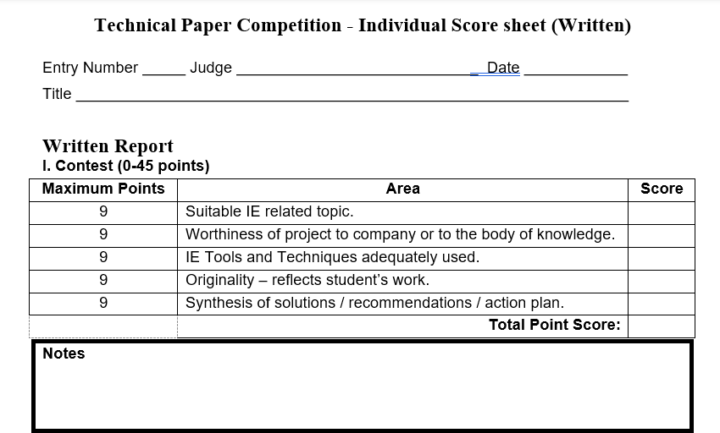
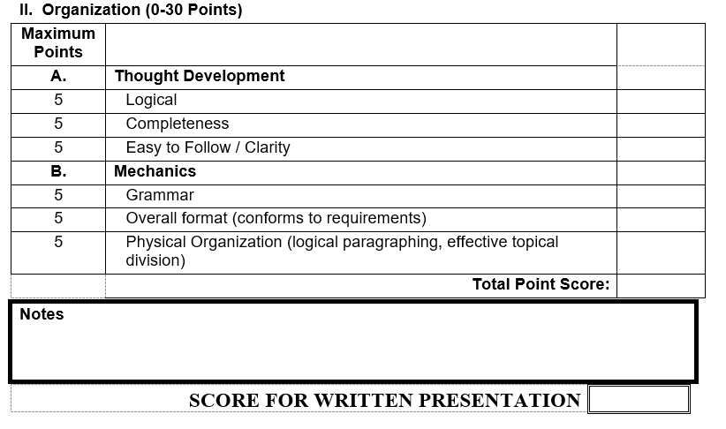
Technical Paper Score Sheet
Judge’s Score Sheet
Notes:
https://app.smartsheet.com/b/form/7fda106ac3a349eeb33f0cac2e32855d

Slide 19
During the Region Business Meeting –
Determine Future Hosts – Required Steps
A minimum of one week before the regional conference, submit a bid to the VP of Student Development at naob-avp@iise.org and Kgamboa@iise.org for verification.
All Universities within the region present at the Conference will have a representative participate in the Business Meeting held during the conference.
Any University interested in hosting upcoming conferences can present their approved bid or presentation at the business meeting. If a representative from a chapter is not present at the conference, they can submit their pre-approved bid to host an upcoming conference prior to the start of the conference. (Note: A bid or presentation should be 1-2 years in advance).
Those present in the meeting will determine the upcoming host rotation with a general vote.
The host rotation list should include up to the next 5 years.
The designated future hosts should be listed on the Final Report submitted by the current hosting University.
IISE Headquarters will maintain the master Host rotation schedule.

Slide 20
Region Business Meeting – Prior Conference Rotation
Region | 2025 | 2024 | 2023 | 2021 | 2020
Mexico - #13 | Instituto Technologico de Merida | Instit. Tech. de. Superior de Poza Rica | Ciudad Madero Tech.Institute | ukn | ukn
Mid Atlantic - #2 | University of Tennessee | NC Agri.&Tech State University | North Carolina State | Clemson, SC | Blacksburg, VT
Middle East - #21 | University of Jordan | University of Jordan | University of Jordan | University of Jordan | University of Jordan
North Central - #6 | University of Wisconsin- Madison | Univ. of ILL. -Urbana-Champagne | S.Dakota School of Mines & tech | Ames, IA | ukn
Northeast - #1 | University at Buffalo | Univ. of Pitt.-Swanson School of Eng. | New York University | ukn | Erie, PA
South Central - #5 | Texas Tech University | University of Arkansas | University of Missouri-Columbia | Stillwater, OK | Stillwater, OK
Southeast - #3 | University of South Florida | Mississippi State University | Central Florida, UCF | ukn | Auburn, AL
Western - #7 | University of Southern California | CA State Poly.Univ. Pomona | Cal Poly San Luis Obispo | Tempe, AZ | Los Angeles, CA
Arabian Peninsula | N / A | N / A | N / A | N / A | N / A
NOTE: 2022 COVID Disruption

Slide 21
Around the room Updates
Middle East Date: Feb.8-9, 2025 Location: The University of Jordan Contact: Haya Masri, Student Conference Chair Contact: Mohannad Jreissat, Faculty Conference Chair Theme: Gen Z in the Driver's Seat: Leading Next Industrial Revolution Website: https://iiseju.com/
U.S. South Central Dates: Feb. 20-22, 2025 Location: Texas Tech University Contact: Kaya Solis, Student Conference Chair Contact: Kaveh Sheikhrezaei, Faculty Conference Chair Website: https://www.iiseatttu.com/
U.S. Mid-Atlantic Dates: Feb. 21-23, 2025 Location: University of Tennessee Contact: Jessie Wilson, Student Conference Chair Contact: Mingzhou Jin, Faculty Conference Chair Theme: "ISE: A World of Possibility" Website: TBD
Canada Dates: January 24-26, 2025 Location: Universite Laval in Quebec Contact: Sarah-Eve Fontaine, Student Chair Contact: Nadia Lehoux, Faculty Conference Chair Theme: TBD Website: https://www.iiselaval2025.com/en
U.S. Western Dates: Feb.28 - March 2, 2025 Location: University of Southern California Contact: Alex Wang, Student Conference Co-chair Contact: Yalda Khashe, Faculty Conference Chair Theme: Innovations in Industrial and Systems Eng. Website: https://conference.usciise.org/
U.S. Southeast Dates: March 7-8, 2025 Location: University of South Florida Contact: Sebastian Rivero Torres, Walter Carranza,
Student Co-Chairs Contact: Michael Weng , Faculty Conference Chair Website: https://www.iisesoutheastconference.com
Mexico Dates: March 11-14, 2025 Location: Instituto Technologico de Merida Contact: Juana Gabriela Mendoza Ponce,
Student Conference Chair Contact: Nicte Ganzo, Faculty Conference Chair Theme: TBD
U.S. Northeast Dates: March 28-30, 2025 Location: University at Buffalo Contact: Catherine Ardizzone, Karen Cheng Student Chairs Contact: Lora Cavuoto, Jun Zhuang, Faculty Co-chairs Theme: Innovation in IE Website: TBD
Central & South America Dates: 8/19-20,2025 Location: Universidad de La Frontera, Temuco, Chile Contact: José Agustín Saíz, Student Chair Contact: Jaime Bustos, Faculty Conference Chair Website: TBD
U.S. Great Lakes Dates: Feb. 7-8, 2025 Location: Purdue University - West Lafayette Contact: Mihika Sane or Rhea Bawa, Student Chair Contact: Barrett Caldwell, Faculty Conference Chair Theme: Emerging Domains Website: https://www.iisepurdue.com/202
U.S. North Central Dates: February 7-8, 2025 Location: University of Wisconsin- Madison Contact: Elliott Frank, Derek Hoffman Student Chairs Contact: Dharmaraj Veeramani , Faculty Conference Chair Theme: The Future of our Field Website: www.iiseuwmadison.com/2025conference

Slide 22
Conclusion
Your Conference will make a lasting impression on your attendees, thanks for all your efforts!
Questions?

Slide 23
Available Contacts
Kathy Gamboa, Director of Membership
Kgamboa@iise.org, 770-349-1104
Emmett Hull, VP of Student Development
Emmett.Hull@bcbsks.com, 785-291-8443
Amy Straub, Membership Coordinator
Astraub@iise.org, 770-349-1115
Website: www.iise.org

