Slide 1
Creating A Culture Committed To Excellence
Institute of Industrial and Systems Engineers
November 16, 2022

Slide 2
Agenda
This webinar will answer four questions:
What is a culture that is committed to excellence?
Why is it important?
How do we assess it?
What can we do to improve it?
Notes:
1. What is a culture that is committed to excellence? Learn about the nine principles that characterize high performing organizations.
2. Why is a culture committed to excellence important? Listen to stories about the culture of excellence in several high performing organizations.
3. How do we assess the culture of excellence in an organization? Learn about the methodology used and the real time results for a global research study that covers this topic. The 'first global assessment on the current state of organizational excellence' launched by the Organizational Excellence Technical Committee QMD ASQ, and conducted by Organizational Excellence Specialists, will provide a snapshot and share the aggregate results on the culture of excellence by organization size, industry sector and region.
4. What can we do to improve the culture of excellence ? Learn about how the nine principles are directly related to best management practices across nine key management areas. Learn how you can help your organization improve the culture of excellence

Slide 3
What Is A Culture Committed
To Excellence?
Notes:
Based on global research over the past 30+ years with high performing organizations, excellence models have defined the principles of excellence
These principles describe the culture of the organization, the way people work with each other and their stakeholders such as customers, suppliers and partners

Slide 4
Principles
Leadership involvement
Alignment
Focus on the customer
People involvement
Prevention based process management
Partnership development
Continuous improvement
Data based decision making
Societal commitment
Organizational Excellence Framework publication (Appendix 2)
Notes:
There are 9 principles:
Leadership involvement – ensuring senior management is committed and actively involved in establishing and communicating direction.
Alignment – understanding the organization is a system of interrelated and interconnected work processes and all activities need to be aligned with the established direction.
Focus on the customer – ensuring the primary aim of everyone in the organization is to understand and meet the needs of the customer.
People involvement – nurturing and reinforcing cooperation and teamwork and giving employees the opportunity to develop their full potential.
Prevention based process management – establishing consistency in work processes and developing a mindset of prevention.
Partnership development – developing and maintaining value-adding relationships with suppliers and partners.
Continuous improvement – harnessing the collective knowledge, skills, and creativity of stakeholders to relentlessly pursue improvement.
Data based decision making – basing decisions on performance measurement findings.
Societal commitment – striving to understand and demonstrate corporate commitment to society

Slide 5
Why Is A Culture Committed To Excellence Important?
Notes:
So, why is a culture committed to excellence important?

Slide 6
Stories
Notes:
Perhaps the best way to capture why a culture of excellence is important, is to provide some examples
Here are stories about two hospitality and tourism organizations that have developed a culture committed to excellence
Both are based on experiences I have had

Slide 7
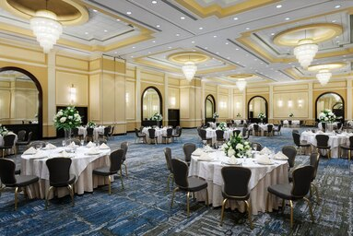
Delta Hotels
Notes:
Delta Hotels:
Has enjoyed improving levels of performance since implementing an excellence model
Stand out from other hotels in the industry with exceptional ratings across a balanced system of measurement and with the number of applications for employment they receive each month
When speaking with Delta GMs about using an excellence model, each reinforced the importance of developing a culture committed to excellence. And when asked about the best thing about implementing the model each GM mentioned something different e.g. leadership, customers, employees, work processes, financial results
Behind the scenes here are some examples of the way Delta works:
Strategy is to attract, engage, and retain people, ensure processes are effective, and continually improve
Website is a powerful tool for recruitment, use video clip of CEO, pictures of people, and employee testimonials, see recruitment as a marketing function (selling jobs and experiences)
Flat organization, employees are empowered to make decisions that affect themselves or customers, employees can talk to the CEO anytime
Mid managers communicate brand-culture-strategy to front line staff
Have quarterly town hall meetings, share business information with employees, get people to talk and generate ideas
Quarterly newsletter shares successes

Slide 8
West Edmonton Mall
Notes:
Worked with WEM to implement an excellence model and noticed the shift in the culture
GM used to spend ½ day per month in the shoes of employees (leadership involvement)
Aligned strategic plan, business plan, employee performance plan and the reward & recognition program to support goals and objectives (alignment)
Had an advisory board that included children and provided feedback on the parks and attractions (focus on customer)
Trained and developed employees and involved them in improvement initiatives (people involvement)
Worked with promotional partners in the hospitality and tourism industry, worked with a few trusted suppliers (partnership development)
Conducted annual assessments to build on strengths and address opportunities for improvement (continuous improvement)
Gave back to the community through donations of attraction passes and volunteer hours (societal commitment)

Slide 9
How Do We Assess The Culture Of
Excellence In An Organization?
Notes:
So, how do you go about assessing the culture of excellence in an organization?

Slide 10
Assessment
To what degree do the principles describe your organizational culture?
Use subjective scale:
Low, 0%-20%
Low-Medium, 21%-40%
Medium, 41%-60%
Medium-High, 61%-80%
High – 81%-100%
Identify strengths
Identify opportunities for improvement
http://organizationalexcellencespecialists.ca/activities/global-oe-index/
Notes:
Use a simple and straightforward method so that everyone in the organization can participate
Explain to employees that the principles describe the way people work together, do business with others, and appear to the marketplace - the culture
Ask them to use a subjective scale that reflects extent to which the principles describe the organizational culture:
Low, 0%-20%
Low-Medium, 21%-40%
Medium, 41%-60%
Medium-High, 61%-80%
High – 81%-100%
And be sure to capture additional comments on strengths and opportunities for improvement that will provide rationale for the ratings and help focus improvement efforts

Slide 11
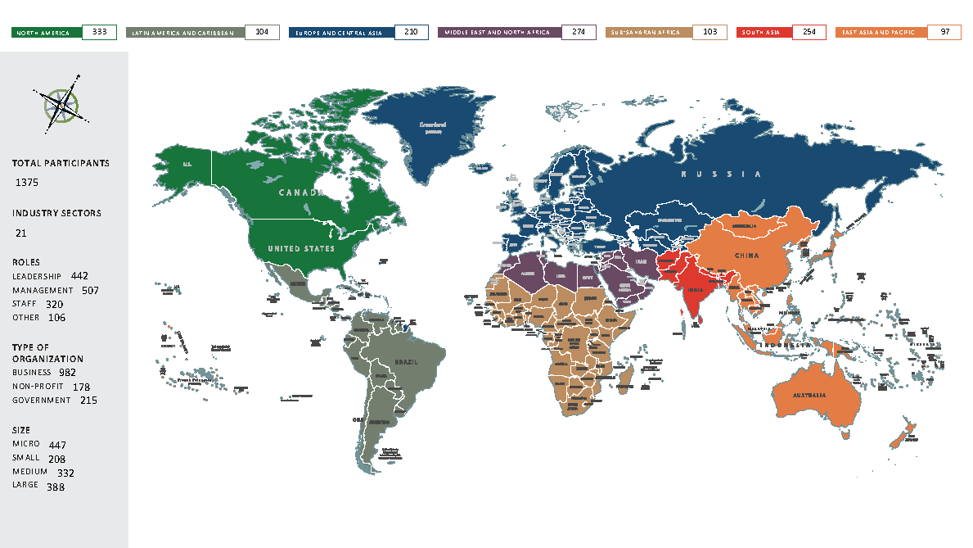
Notes:
ORGANIZATIONS – 1375 ; INDUSTRY SECTORS – 21 ; REGIONS - 7
Type: Business 982 ; Non-Profit 178 ; Government – 215
Role: Leadership – 442 ; Management – 507 ; Staff – 320 ; Other – 106
Size: Micro – 447 ; Small – 208 ; Medium – 332 ; Large - 388

Slide 12
Teaser Assessment
Notes:
All the Principles received ratings in the ‘medium high’ range (6.1 to 8.0).
The most highly rated Principles were ‘Leadership Involvement’ and ‘Focus on the customer’.
The lowest rated were ‘Prevention based process management’ and ‘Data based decision making’.

Slide 13
What Can We Do To Improve The
Culture Of Excellence ?
Notes:
So, once we have captured the current state on the culture of excellence and have compared it to others, what can we do to improve low rated principles?
For example, DBDM rated at 6.2

Slide 14
Understand Interrelationships
Touch Points
Best Management Practices
Principles
Notes:
First step is to consider ‘interrelationships’
In an excellence model, the principles are directly related to the best management practices
In other words, these practices influence the principles

Slide 15
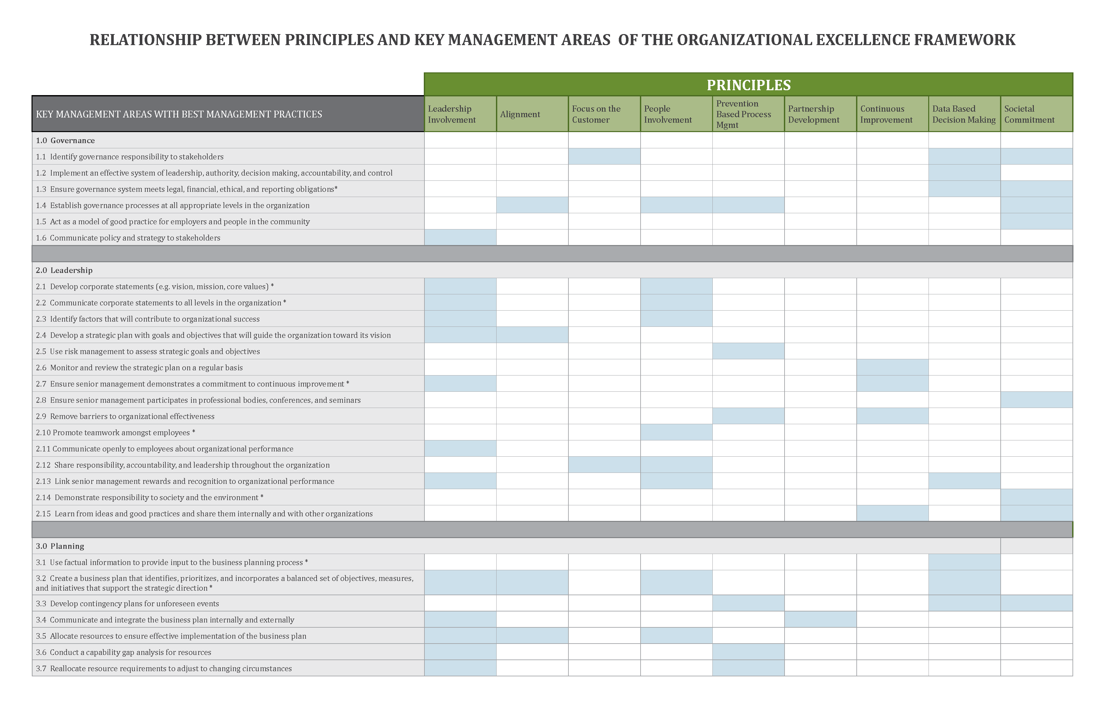
https://organizationalexcellencespecialists.ca/wp-content/uploads/2018/03/OES_RelationshipDocument_March28.pdf
Notes:
Here is a handy chart that can be used as a diagnostic
Along the top of the chart are the 9 principles
Running down the left-hand side of the chart are the best management practices in each key management area
Simply record the average ratings for each of the principles and the practices
For the principles that have a lower rating, scan down the chart to find the touch points with best practices that also have a low rating
This is where you should concentrate effort

Slide 16
Principles and Practices
Leadership involvement - 28
Alignment - 19
Focus on the customer - 24
People involvement - 36
Prevention based process management - 32
Partnership development - 17
Continuous improvement - 53
Data based decision making - 57
Societal commitment - 23
TOUCH POINTS
Interrelationships @ https://organizationalexcellencespecialists.ca/
Notes:
There are quite a few touch points between each of the principles and best management practices
You can appreciate these interrelationships in more detail by downloading two documents on the home page of the website:
Organizational Excellence Framework publication
Interrelationships document
In the GRS, the lowest rated Principal for the World was DBDM (rated at 6.2). There 57 related practices and the lowest rated was: Practice 6.9 Involve customers, suppliers and partners in designing and analyzing processes (rated at 4.35)
We can also look at the aggregate results for an organization, an industry sector or a country. For United States, the lowest rated principle was PBPM and the lowest rated practice was under the Work Processes area – Practice 6.10 Use external data to compare performance to others (rated at 2.19)

Slide 17
Some Ideas
Assessment
Improvement planning
Meetings
Workshops
Site visits
Benchmarking
Notes:
What else can you do to improve the culture of excellence?
Here are a few ideas:
Offer workshops
Do the Full Assessment
Hold meetings to gather ideas and suggestions
Conduct site visits
Learn from other organizations

Slide 18
A Formula For Success
Implement best management practices
Develop a culture committed to excellence
Achieve exceptional results
Notes:
The culture of excellence is very important
It is part of the ‘formula for success’ = Implement the best practices found in excellence models, Develop a culture committed to excellence, Achieve exceptional results across a balanced system of measurement
It tried and true. There are 30+ years of research with excellence models that has validated this formula (~1990 to date)
The OEF combines the leading excellence models and is unique in that it provides implementation guidelines. There is an accompanying toolkit that helps make improving performance more simple, straightforward, time efficient and cost effective
It also allows you to integrate your subject matter expertise, approaches, tools and techniques and provides support if your organization wants to apply for a national excellence award

Slide 19
Next Steps
Visit http://organizationalexcellencespecialists.ca/activities/global-oe-index/
Take the teaser assessment
Read the reports on the global research study
Compare ratings with others
Improve low rated principles
Learn from high performing organizations
Notes:
Some next steps for those that want to dive into this topic are:
Take the teaser assessment on the 9 principles to see how your organization measures up
Read the final report on the global research study
Compare your organization ratings to others
OR
Take the full assessment that allows you to assess the principles and practices and improve low rated principles by:
studying interrelationships
focusing on low rated practices
soliciting ideas and suggestions internally
Learning from high performing organizations externally

Slide 20
Thank You !
Dawn Ringrose MBA FCMC
Principal, Organizational Excellence Specialists
Executive, OETC QMD ASQ
Board, ISCM Foundation
dawn@organizationalexcellencespecialists.ca
Notes:
Thank you for your kind attention
Let’s turn the session now to answer any questions

