Slide 1
OVERALL
EQUIPMENT
EFFICIENCY
Principles, Applications, and Analysis

Slide 2
“You can not improve what you can not measure”
—Peter Drucker/William Thomson

Slide 3
Table of contents
01
Understanding OEE
02
OEE as a Business Tool
History and Definition
Benefits of using OEE
03
OEE Calculation
04
OEE as a driver for Improvement
OEE Components
Analysis, Improvement

Slide 4
01
Understanding
OEE

Slide 5
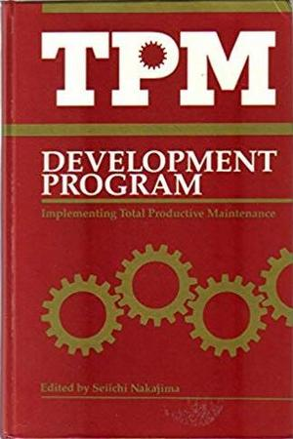
History of OEE
The concept of OEE -Overall Equipment Effectiveness was written about by Seiichi Nakajima in 1989
Notes:
Seiichi Nakajima is from Japan Institute of Plant Maintenance
TPM Development Program was translated from Japanese book TPM Tenkai published in 1982
OEE was first described –as a central component of the TPM methodology- in Seiichi Nakajima’s book ‘TPM tenkai’ (1982, JIPM Tokyo).
By the end of the 1980’s, the concept of TPM became more widely known in the Western world. At the time, Productivity Press (OR, USA) published English translations of two books by JIPM expert Seiichi Nakajima: Introduction to TPM and TPM Development Program.

Slide 6
History of OEE
Fuji (Holland)
Largest investment
outside of Japan
3 factories
Zero Defects, Zero Loss
Arno Koch (US)
OEE Toolkit
OEE for Operators
1980s
End of 1990s
1995
Present
SEMATECH (US)
OEE Benchmarking
Semiconductor Manufacturing Productivity OEE Guidebook
Notes:
1. Around the same time, in Europe, Fuji Photo-Film made the largest investment ever done outside of Japan so far, building 3 factories in Holland. The challenge for the factory management:
“Producing Zero Defect and Zero Loss, using Japanese principles in a Western environment”.
Fuji’s Director Steven Blom resumes:
“Measure OEE and eliminate the losses, using Small Group Activities”.
Around 1995, in the semiconductor industry SEMATECH publishes its ‘Semiconductor Manufacturing Productivity Overall Equipment Effectiveness (OEE) Guidebook‘ with guidelines for OEE implementation is semiconductor manufacturing.
At the end of the ’90s, Arno Koch worked closely together with the editors and authors of Productivity Press, publishing ‘OEE Toolkit’ (the predecessor of OEE Coach) and ‘OEE for Operators’ (part of the Shingo Prize winning shopfloor series).
This effectively made OEE accessible and feasible for many Western companies’ production departments.
OEE Industry Standard (Holland)
On request of several OEE-using multinationals, Koch initiated in 2001 the “OEE Industry Standard Endeavour” that resulted in the OEE Industry Standard, since then offering OEE definitions and -standards to manufacturers around the globe. (see: OEE Industry Standard)
Hansen (US)
In the same year 2001 Bob Hansen wrote his book “Overall Equipment Effectiveness” attempting to clarify the steep learning curve to use OEE effectively with emphasis on maintenance and reliability.
CETPM (Germany)
In 2006 In Germany, at the Ansbach University of Applied Technology, Prof. Dr. Constantin May starts the Centre of Excellence for TPM (CETPM). OEE courses become a standard in its curriculum; in the TPM-instructor course, instructors are now systematically trained how to apply OEE.
Meanwhile OEE is being used worldwide in virtually every kind of production-process thinkable.
The experience gained by applying OEE to a vast number of incredibly diverse machines and equipment both in batch processes and discrete industries throughout the entire world, subsequently ensured that these ‘interesting theories’ were modeled into the practical tools that you will read about on this site.
Koch (Holland – Germany)
After writing “OEE Toolkit” (1995) and co-creating “OEE for operators” (1999), the vast amount of implementation insights gained so far, result in a “complete OEE user guide”, first written by Arno Koch in 2007, updated in 2015, titled; “OEE for the Production Team”, available in English and Dutch, in German since 2008 and in Portuguese since 2013.

Slide 7
History of OEE
Why was OEE needed in the
first place?
Notes:
1. Around the same time, in Europe, Fuji Photo-Film made the largest investment ever done outside of Japan so far, building 3 factories in Holland. The challenge for the factory management:
“Producing Zero Defect and Zero Loss, using Japanese principles in a Western environment”.
Fuji’s Director Steven Blom resumes:
“Measure OEE and eliminate the losses, using Small Group Activities”.
Around 1995, in the semiconductor industry SEMATECH publishes its ‘Semiconductor Manufacturing Productivity Overall Equipment Effectiveness (OEE) Guidebook‘ with guidelines for OEE implementation is semiconductor manufacturing.
At the end of the ’90s, Arno Koch worked closely together with the editors and authors of Productivity Press, publishing ‘OEE Toolkit’ (the predecessor of OEE Coach) and ‘OEE for Operators’ (part of the Shingo Prize winning shopfloor series).
This effectively made OEE accessible and feasible for many Western companies’ production departments.
OEE Industry Standard (Holland)
On request of several OEE-using multinationals, Koch initiated in 2001 the “OEE Industry Standard Endeavour” that resulted in the OEE Industry Standard, since then offering OEE definitions and -standards to manufacturers around the globe. (see: OEE Industry Standard)
Hansen (US)
In the same year 2001 Bob Hansen wrote his book “Overall Equipment Effectiveness” attempting to clarify the steep learning curve to use OEE effectively with emphasis on maintenance and reliability.
CETPM (Germany)
In 2006 In Germany, at the Ansbach University of Applied Technology, Prof. Dr. Constantin May starts the Centre of Excellence for TPM (CETPM). OEE courses become a standard in its curriculum; in the TPM-instructor course, instructors are now systematically trained how to apply OEE.
Meanwhile OEE is being used worldwide in virtually every kind of production-process thinkable.
The experience gained by applying OEE to a vast number of incredibly diverse machines and equipment both in batch processes and discrete industries throughout the entire world, subsequently ensured that these ‘interesting theories’ were modeled into the practical tools that you will read about on this site.
Koch (Holland – Germany)
After writing “OEE Toolkit” (1995) and co-creating “OEE for operators” (1999), the vast amount of implementation insights gained so far, result in a “complete OEE user guide”, first written by Arno Koch in 2007, updated in 2015, titled; “OEE for the Production Team”, available in English and Dutch, in German since 2008 and in Portuguese since 2013.

Slide 8
History of OEE
Situation A – 10 hr breakdown, after every 90 hrs
RUNS 90 HRS | STOPS 10 HRS
Total: 100 hrs
Situation B – 1 hr breakdown, every 9 hrs
Total: 100 hrs
Notes:
1. Around the same time, in Europe, Fuji Photo-Film made the largest investment ever done outside of Japan so far, building 3 factories in Holland. The challenge for the factory management:
“Producing Zero Defect and Zero Loss, using Japanese principles in a Western environment”.
Fuji’s Director Steven Blom resumes:
“Measure OEE and eliminate the losses, using Small Group Activities”.
Around 1995, in the semiconductor industry SEMATECH publishes its ‘Semiconductor Manufacturing Productivity Overall Equipment Effectiveness (OEE) Guidebook‘ with guidelines for OEE implementation is semiconductor manufacturing.
At the end of the ’90s, Arno Koch worked closely together with the editors and authors of Productivity Press, publishing ‘OEE Toolkit’ (the predecessor of OEE Coach) and ‘OEE for Operators’ (part of the Shingo Prize winning shopfloor series).
This effectively made OEE accessible and feasible for many Western companies’ production departments.
OEE Industry Standard (Holland)
On request of several OEE-using multinationals, Koch initiated in 2001 the “OEE Industry Standard Endeavour” that resulted in the OEE Industry Standard, since then offering OEE definitions and -standards to manufacturers around the globe. (see: OEE Industry Standard)
Hansen (US)
In the same year 2001 Bob Hansen wrote his book “Overall Equipment Effectiveness” attempting to clarify the steep learning curve to use OEE effectively with emphasis on maintenance and reliability.
CETPM (Germany)
In 2006 In Germany, at the Ansbach University of Applied Technology, Prof. Dr. Constantin May starts the Centre of Excellence for TPM (CETPM). OEE courses become a standard in its curriculum; in the TPM-instructor course, instructors are now systematically trained how to apply OEE.
Meanwhile OEE is being used worldwide in virtually every kind of production-process thinkable.
The experience gained by applying OEE to a vast number of incredibly diverse machines and equipment both in batch processes and discrete industries throughout the entire world, subsequently ensured that these ‘interesting theories’ were modeled into the practical tools that you will read about on this site.
Koch (Holland – Germany)
After writing “OEE Toolkit” (1995) and co-creating “OEE for operators” (1999), the vast amount of implementation insights gained so far, result in a “complete OEE user guide”, first written by Arno Koch in 2007, updated in 2015, titled; “OEE for the Production Team”, available in English and Dutch, in German since 2008 and in Portuguese since 2013.

Slide 9

What is OEE
OEE (Overall Equipment Effectiveness) is both a process monitoring and process improvement tool
A framework of measuring the efficiency of a process, line, or machine

Slide 10

What is OEE
A “best practices” way to continuously improve the effectiveness of manufacturing processes

Slide 11
What is OEE
Takes into account the most common losses, and narrows them down into metrics that provide excellent gauge for measuring where you are – and how you can improve

Slide 12
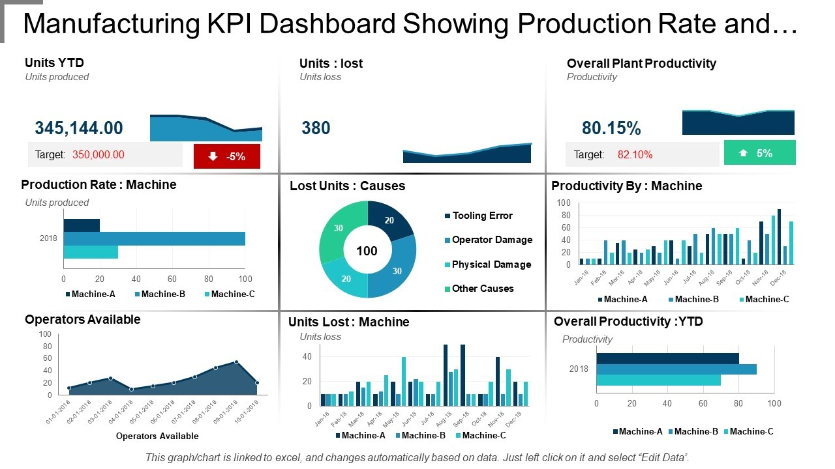
What is OEE
Takes into account the most common losses, and narrows them down into metrics that provide excellent gauge for measuring where you are – and how you can improve

Slide 13
02
OEE as a Business Tool

Slide 14
Why use OEE
It helps us to see and understand the current process and system status.
It facilitates in making our improvement plans
It helps us measure our performance

Slide 15
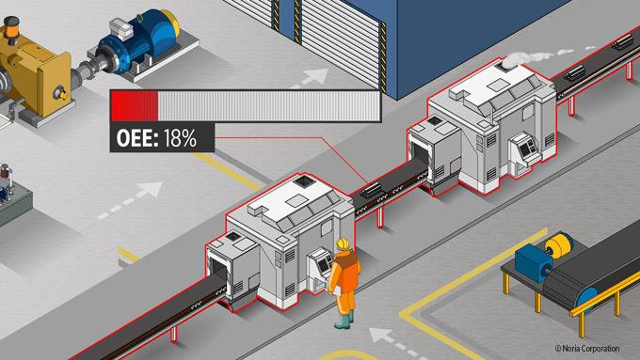
Why use OEE

Slide 16
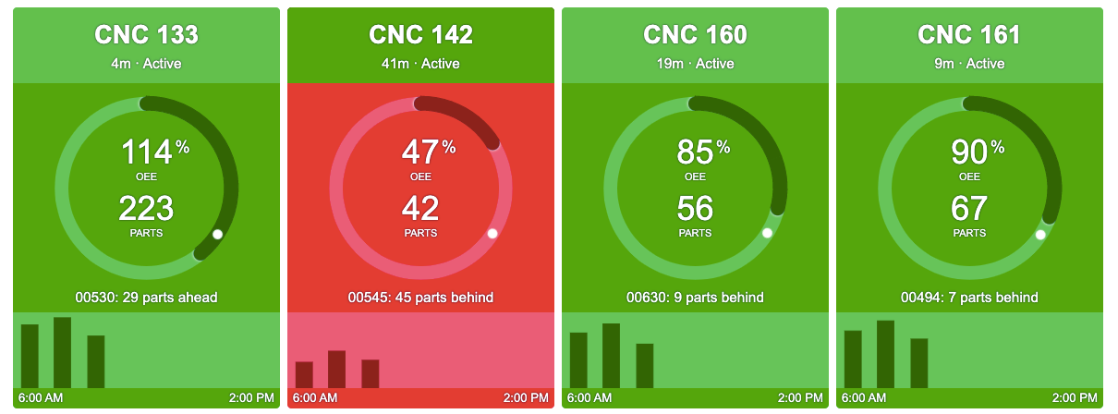
Why use OEE

Slide 17

Why use OEE
Notes:
COST REDUCTION – remain competitive in the market

Slide 18

Why use OEE
Notes:
GROWTH – expansion capabilities

Slide 19

Why use OEE
Notes:
Profit maximization - Capital is used as effectively as possible

Slide 20

Why use OEE
Notes:
Process Optimization and Improvement – line balancing, manpower utilization, energy consumption, yield improvement, output and capacity increase

Slide 21

Why use OEE
Notes:
Risk Minimization -- Identify and minimize production risks, failure risks

Slide 22

Why use OEE
Notes:
Solve problem to root cause -- Reducing fire fighting, analyzing problems and eliminating them sustainably

Slide 23
03
OEE Calculation
42%
58%

Slide 24
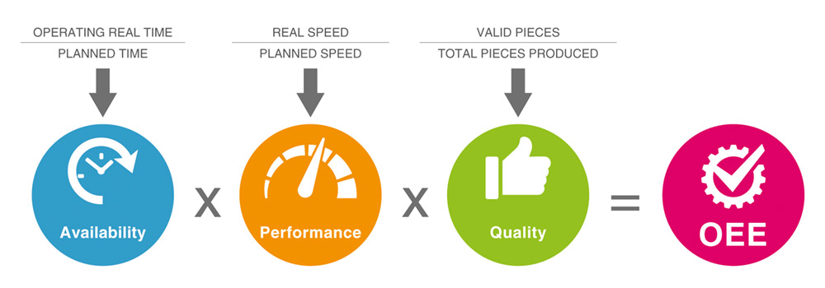
OEE COMPONENTS
Availability accounts for when the process is not running both Unplanned Stops and Planned Stops.
Notes:
Solve problem to root cause -- Reducing fire fighting, analyzing problems and eliminating them sustainably

Slide 25
OEE COMPONENTS
Performance accounts for when the process is running slower than its theoretical top speed.
Notes:
Performance accounts for when the process is running slower than its theoretical top speed.

Slide 26
OEE COMPONENTS
Quality accounts for manufactured parts that do not meet set quality standards
Notes:
Quality accounts for manufactured parts that do not meet set quality standards.

Slide 27
OEE CALCULATION
Notes:
Quality accounts for manufactured parts that do not meet set quality standards.

Slide 28
04
OEE as a driver for improvement

Slide 29
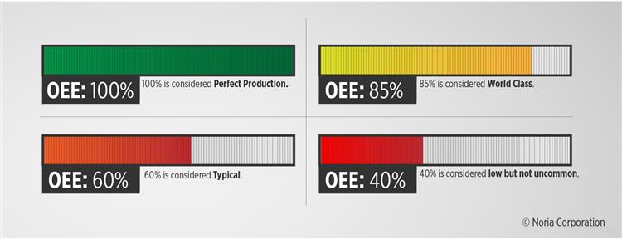
OEE ANALYSIS
Notes:
Quality accounts for manufactured parts that do not meet set quality standards.

Slide 30
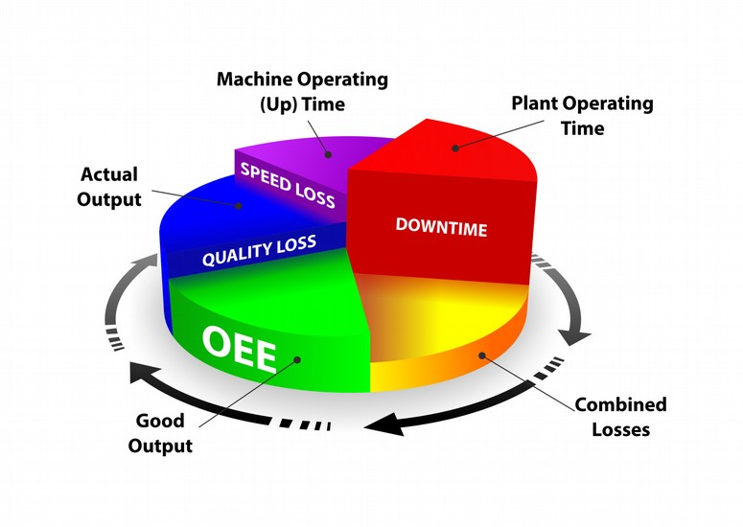
OEE ANALYSIS
Notes:
Quality accounts for manufactured parts that do not meet set quality standards.

Slide 31
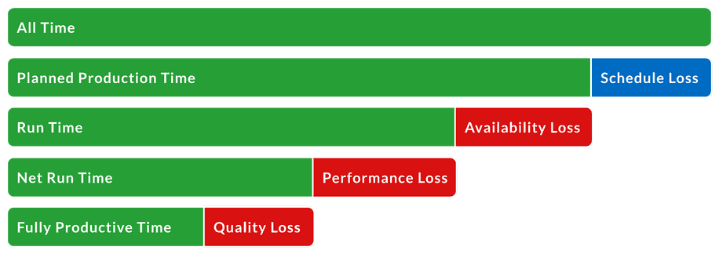
OEE ANALYSIS
Notes:
Quality accounts for manufactured parts that do not meet set quality standards.

Slide 32
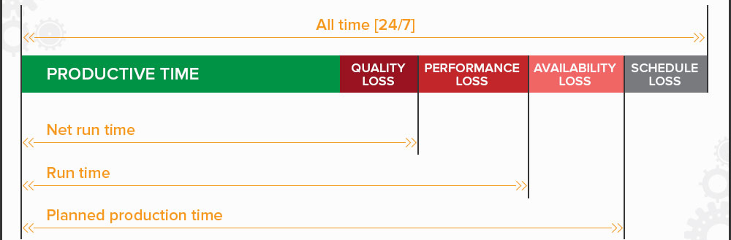
OEE ANALYSIS
Notes:
Quality accounts for manufactured parts that do not meet set quality standards.

Slide 33
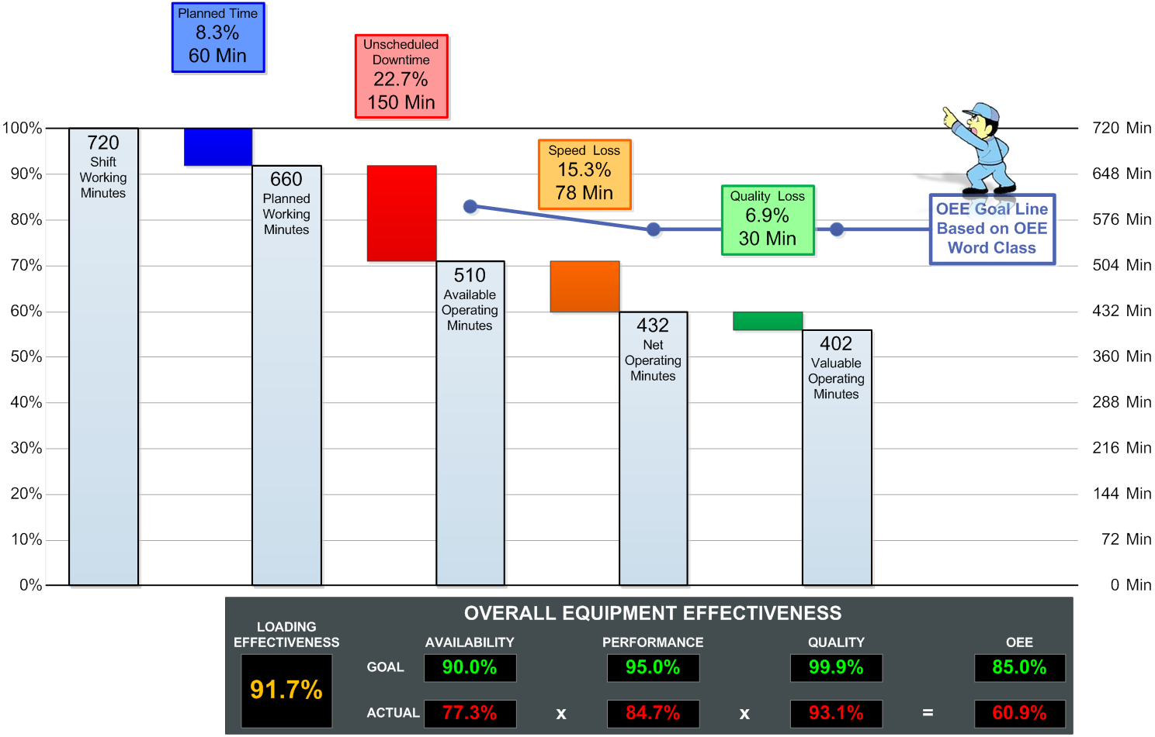
OEE ANALYSIS
Notes:
Quality accounts for manufactured parts that do not meet set quality standards.

Slide 34
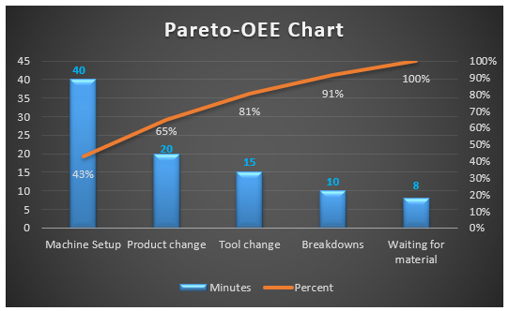
OEE IMPROVEMENT
Notes:
Quality accounts for manufactured parts that do not meet set quality standards.

Slide 35
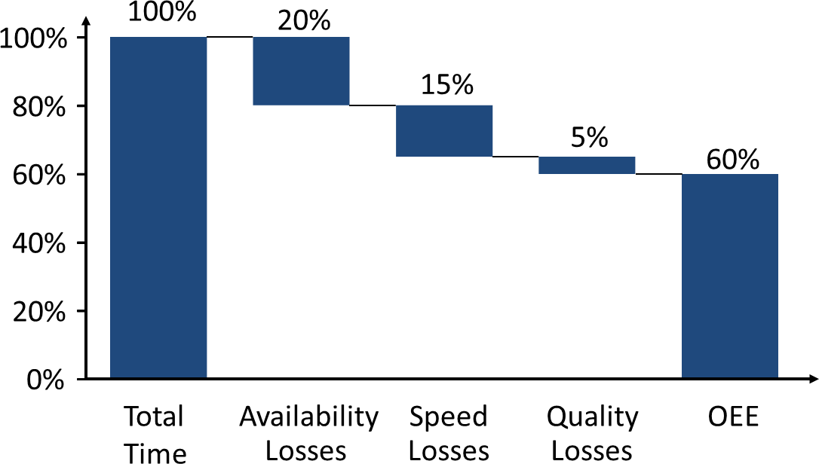
OEE IMPROVEMENT
Notes:
Quality accounts for manufactured parts that do not meet set quality standards.

Slide 36
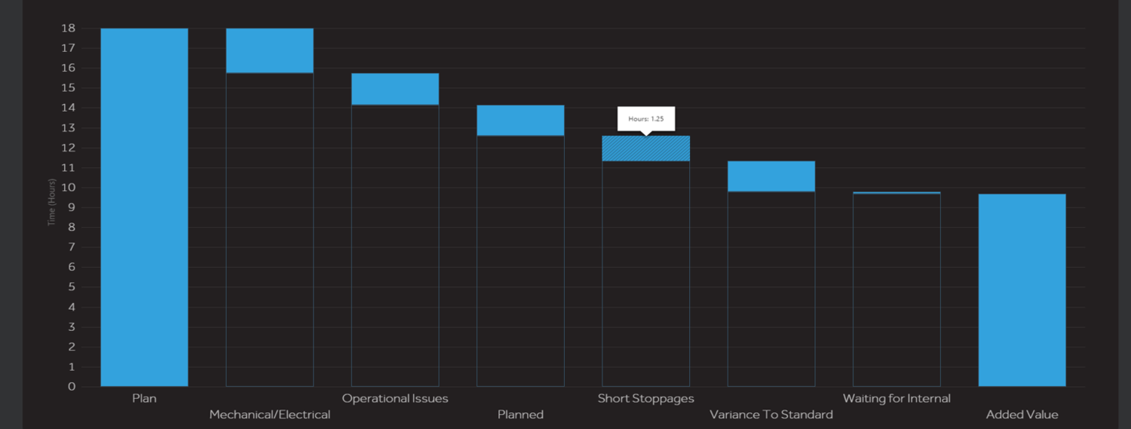
OEE IMPROVEMENT
Notes:
Quality accounts for manufactured parts that do not meet set quality standards.

Slide 37
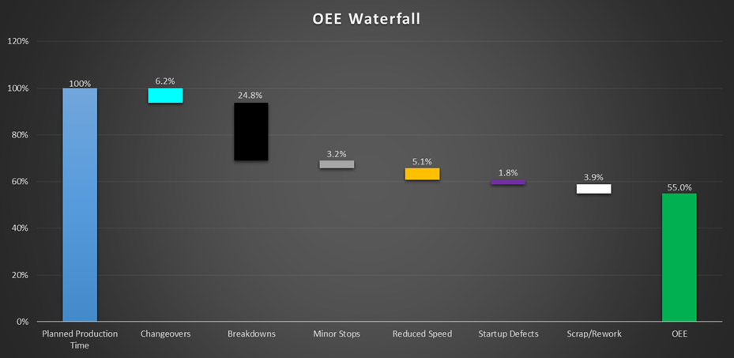
OEE IMPROVEMENT
Notes:
Quality accounts for manufactured parts that do not meet set quality standards.

Slide 38
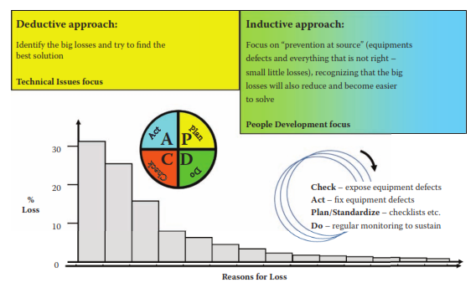
OEE IMPROVEMENT
Notes:
Quality accounts for manufactured parts that do not meet set quality standards.

Slide 39
OEE FINAL REMINDERS!
Notes:
Quality accounts for manufactured parts that do not meet set quality standards.

Slide 40

Notes:
Quality accounts for manufactured parts that do not meet set quality standards.

Slide 41

Notes:
Quality accounts for manufactured parts that do not meet set quality standards.

Slide 42
MARK ANTHONY CARO
mdcaro@up.edu.ph
Project Management
Engineering and Maintenance
TPM
Lean Manufacturing
Energy/Environment/Quality Management

