Slide 1
AI-Enabled Models to Assist and Optimize the Decision-Making Process in the Kidney Transplantation Network
Cihan H Dagli, PhD, Professor, Founder and Director of Systems Engineering Graduate Program
Engineering Management and Systems Engineering Department
March 11, 2024

Slide 2
Presentation Outline
Background (Kidney Allocation)
Organ Procurement and Transplantation Network (OPTN) Data
Identify Model Development Opportunities
AI-Model Development
AI Models to Support Decision-Making Process
AI-Use Case and Discussion

Slide 3
Background
Nearly 786,000 Americans are diagnosed with end-stage renal disease (ESRD)
A decline in kidney function
71% receive renal replacement therapy through dialysis
29% receive renal replacement therapy through a kidney transplant
ESRD patients can be listed with transplant centers as candidates seeking kidney transplant
A kidney transplant offers greater survival benefits and improved quality of life and is usually cost-effective
(Focus) Renal replacement therapy through a kidney transplant
There are 90K to 100K people on the waitlist
As of 12/11/2022, there are 89,622 waitlisted candidates
The median wait time for a first kidney transplant is 3.6 years, usually higher for adults.
In 2022, there were 25,500 kidneys transplanted
5,864 from living donors and others from deceased donors

Slide 4
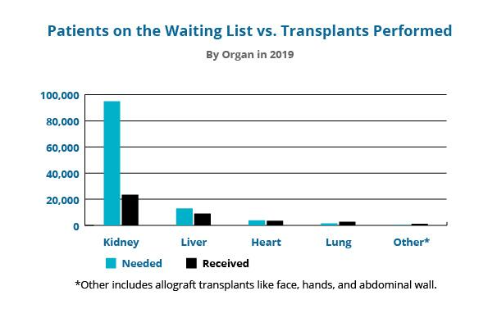
Background
Deceased Donor Kidneys (DDK)
~ 20% of the DDK are non-utilized for many reasons
Kidney quality
Failure to identify a PTR on time
Accrued cold ischemia time that reduced the quality of kidney
Biopsy results unacceptable
Supply Shortage
Longer wait times increase waitlist mortality
“Multiple listing” may reduce waiting time

Slide 5
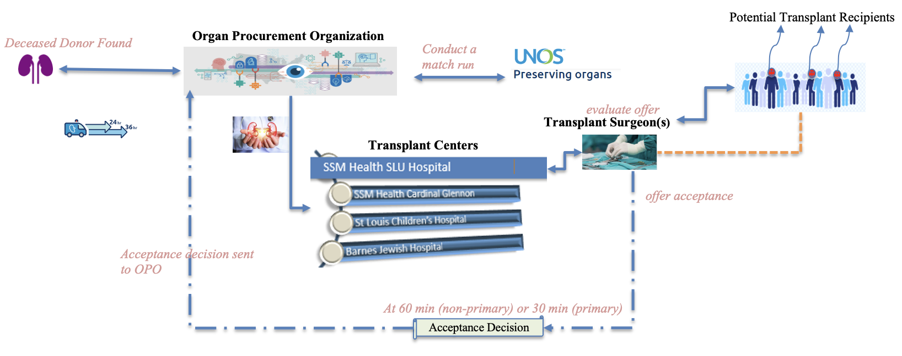
Background
DDK Allocation OV-1

Slide 6
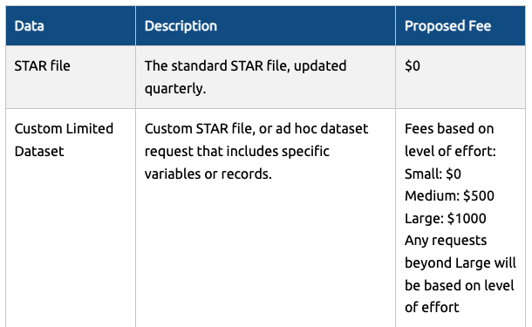
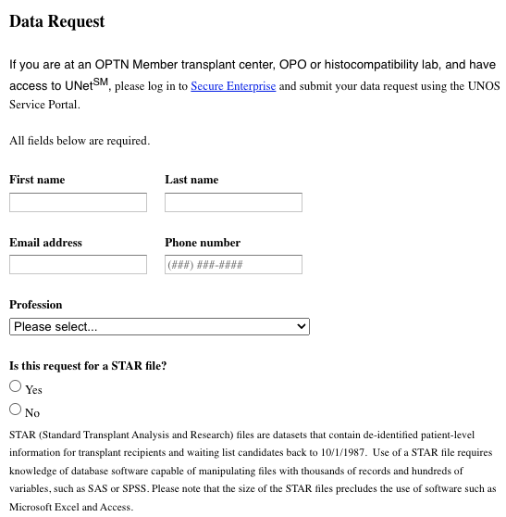
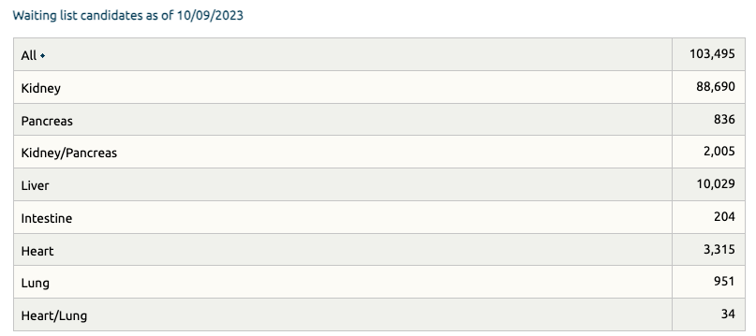
OPTN Data
Request OPTN Data
https://optn.transplant.hrsa.gov/data/view-data-reports/request-data/

Slide 7
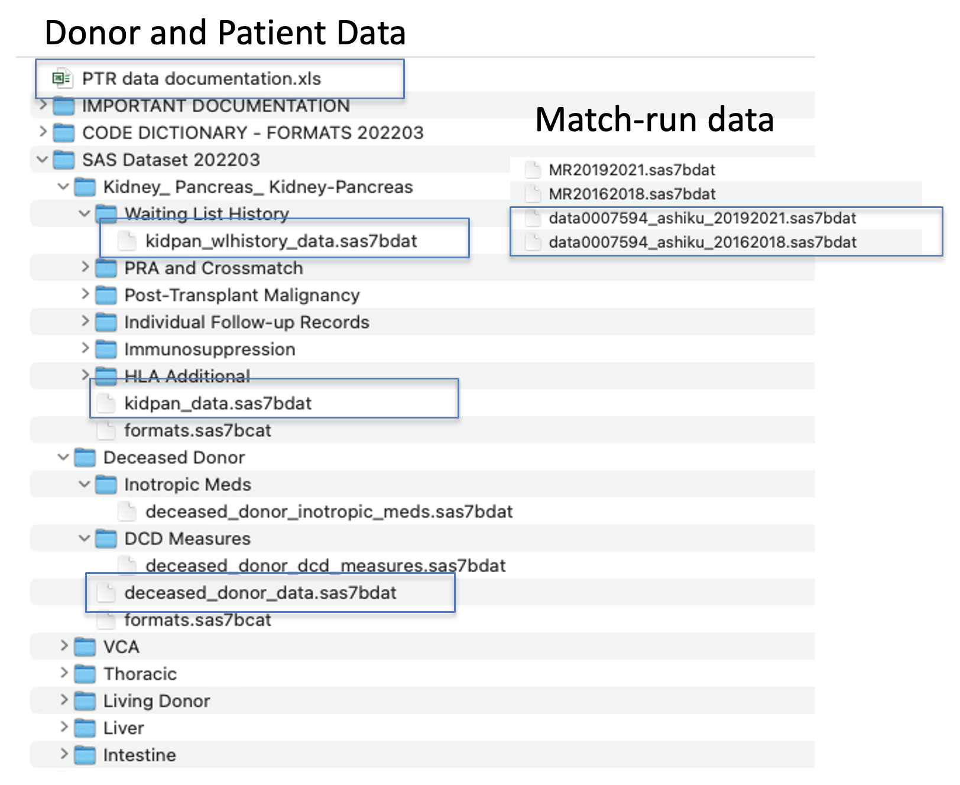
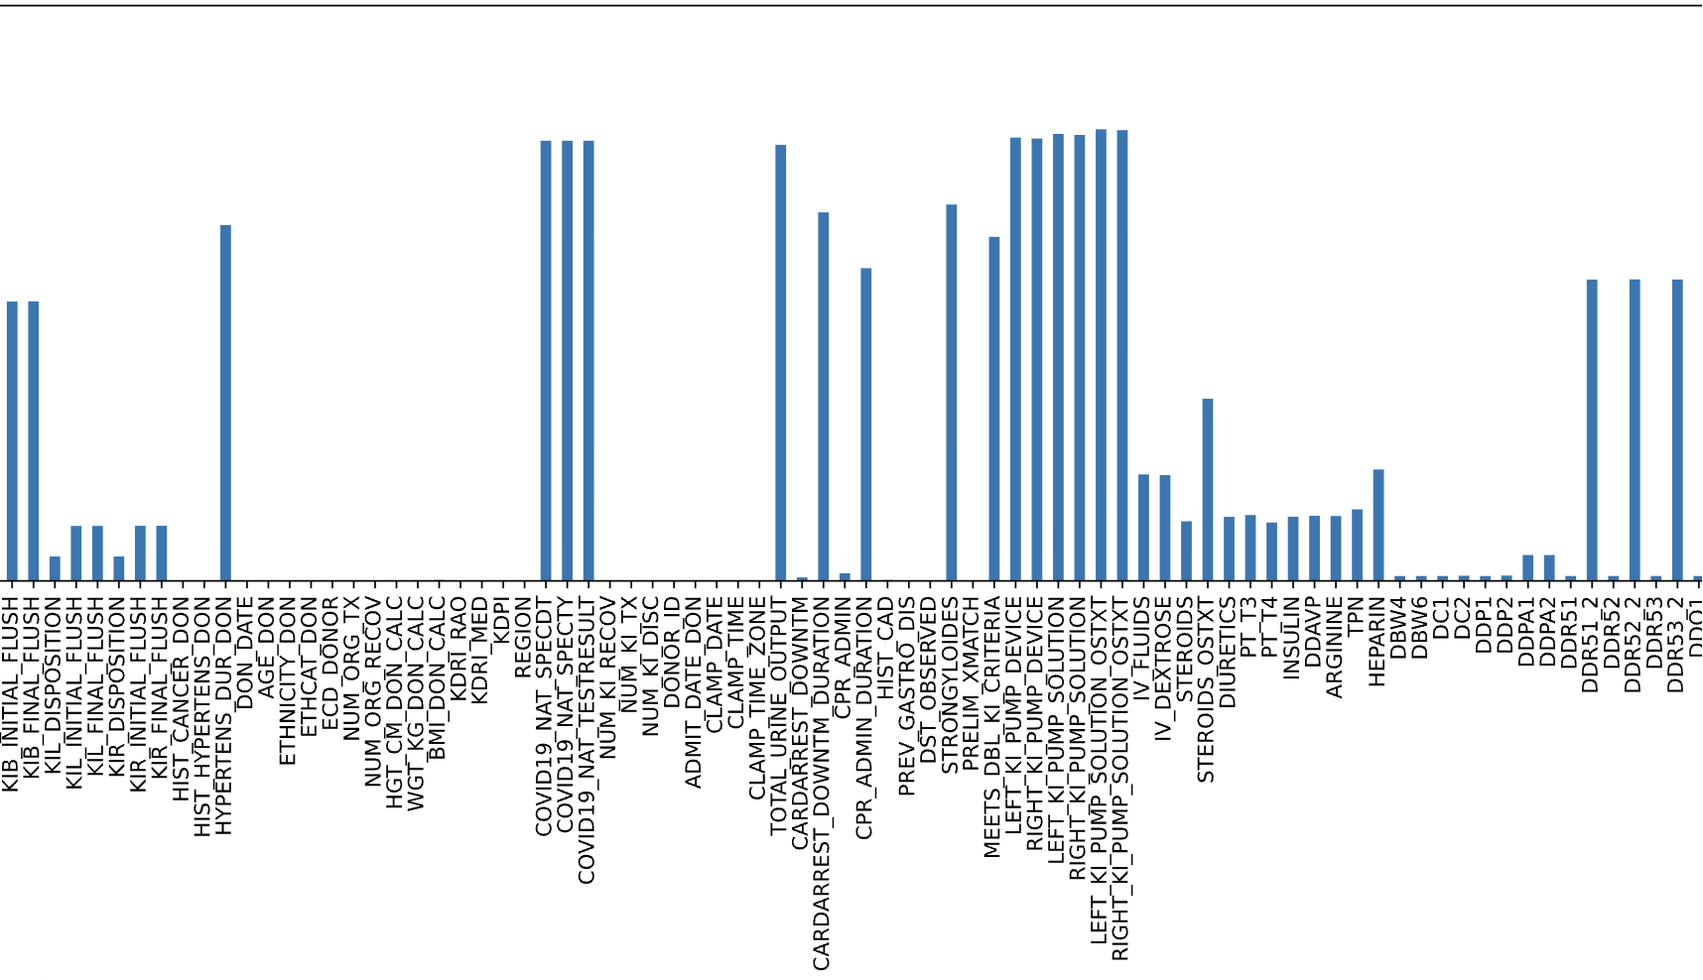
OPTN Data

Slide 8
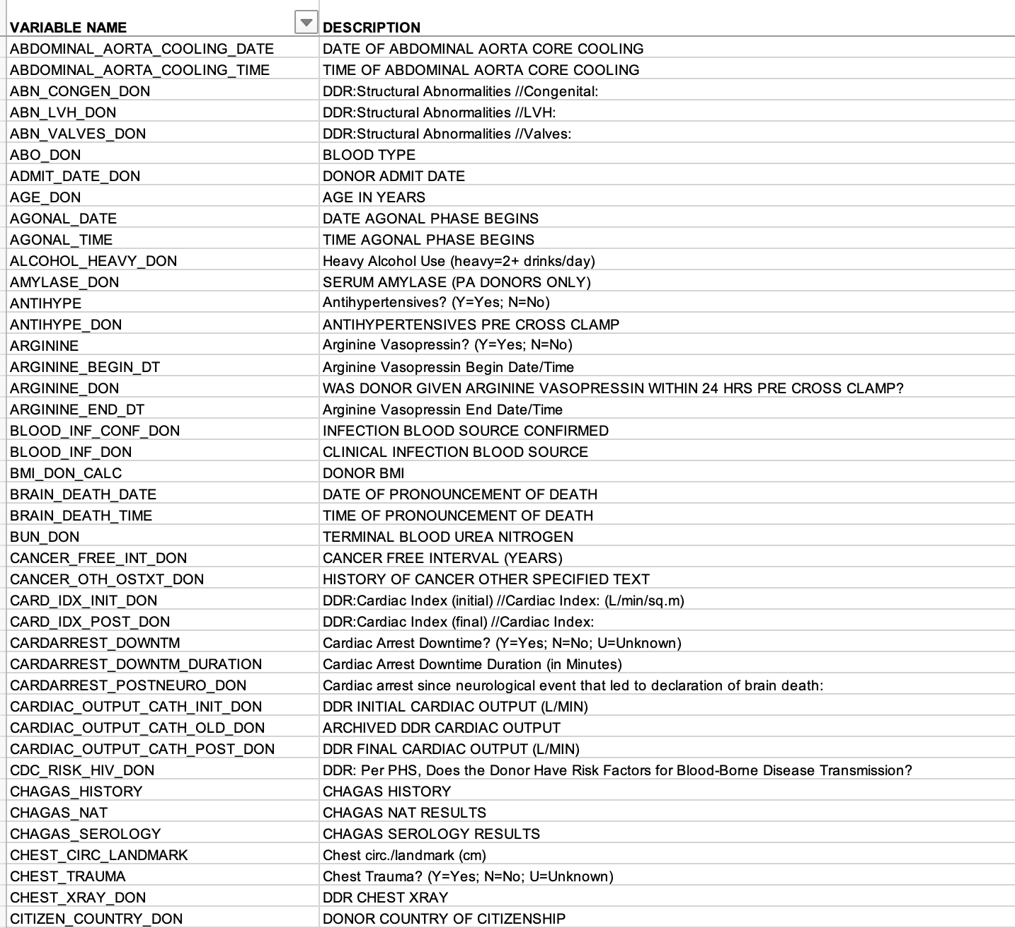
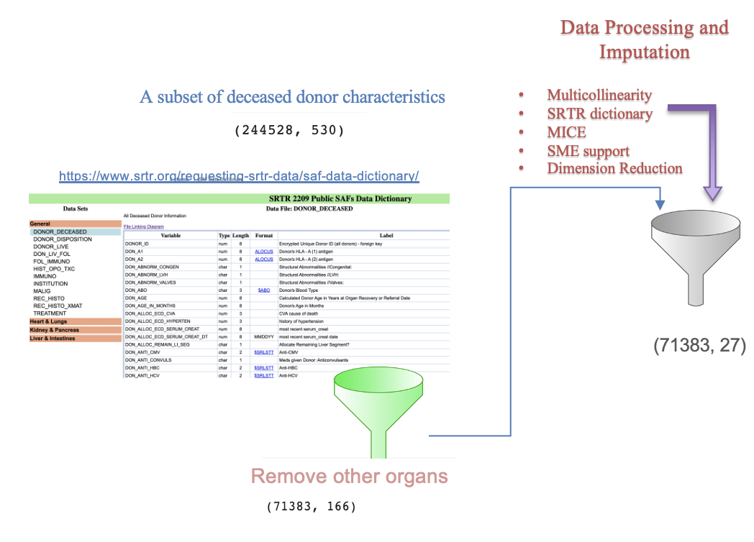
OPTN Data, Processing and Imputation

Slide 9
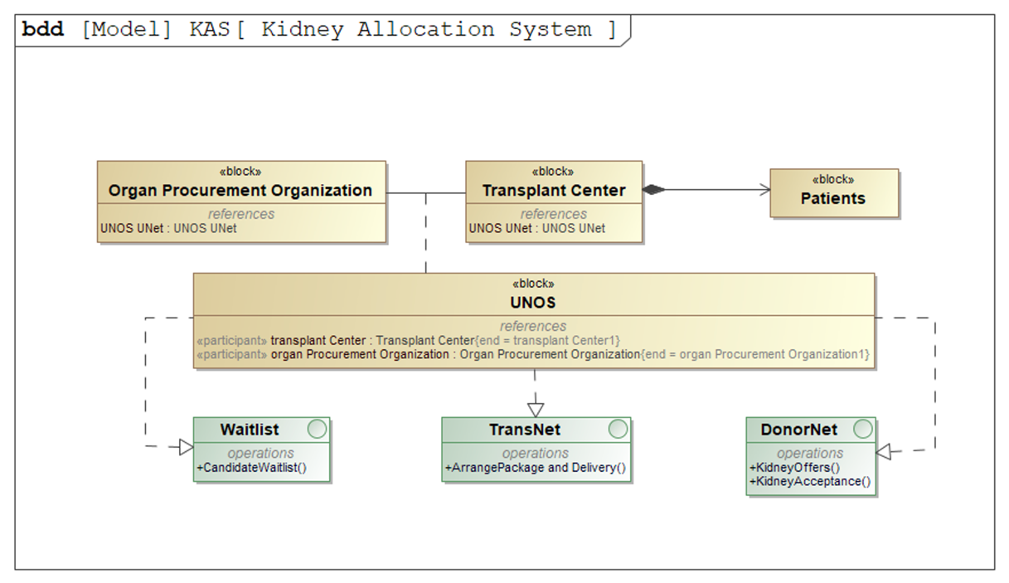
Identify Model Development Opportunities
Stakeholders in the Kidney Allocation System

Slide 10
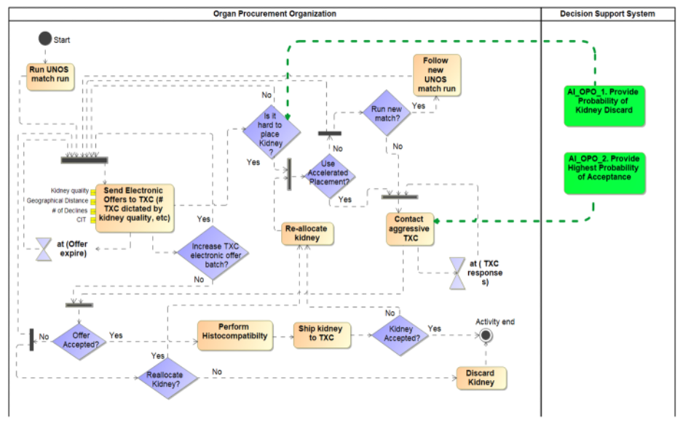
Identify Model Development Opportunities
Organ Procurement Organization
Not-for-profit organizations
Recover organs
Work with the decedent's family to authorize donation
Assess donor potential
Record donor characteristics
Perform Match-run United Network for Organ Sharing (UNOS) UNet
Present offers to transplant centers
Perform histocompatibility
Procure organs
Deliver organs
Ashiku L, Threlkeld R, Canfield C, Dagli C. Identifying AI opportunities in donor kidney acceptance: Incremental hierarchical systems engineering approach. 2022 IEEE International Systems Conference (SysCon). 2022. doi:10.1109/syscon53536.2022.9773875

Slide 11
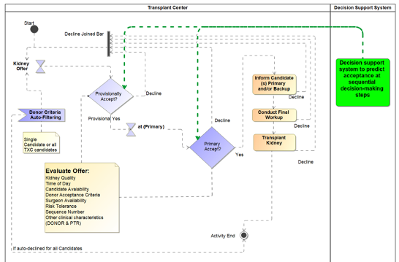
Identify Model Development Opportunities
Transplant Center
Assess organ offers
Engage candidates in decision-making (potential)
Add/remove candidates from waitlist
Modify acceptance criteria
Transplant kidney
Ashiku L, Threlkeld R, Canfield C, Dagli C. Identifying AI opportunities in donor kidney acceptance: Incremental hierarchical systems engineering approach. 2022 IEEE International Systems Conference (SysCon). 2022. doi:10.1109/syscon53536.2022.9773875

Slide 12
AI-Model Development
Identified three useful models
Hard-to-place kidneys (likely to be non-utilized when following the offer sequence)
Potential increase in utilization rate when jumping sequence.
Provisional acceptance (surgeon response for later sequence offers –nonprimary offer)
Offers higher up in the sequence must be declined before a kidney offer becomes primary to other matches on the list; therefore, a nonprimary offer is a potential offer.
A transplant center (surgeon) is allocated 60 minutes to provide a response (auto-declined if there is no response)
This is not a firm commitment, but rather wanting to revisit the offer when the current sequence is now at the top of the list
Primary acceptance (surgeon response to current offer –primary offer)
The offer is firm; if not accepted, it goes down the sequence list.
The response can be pending biopsy results
The response can change up to transplant time

Slide 13
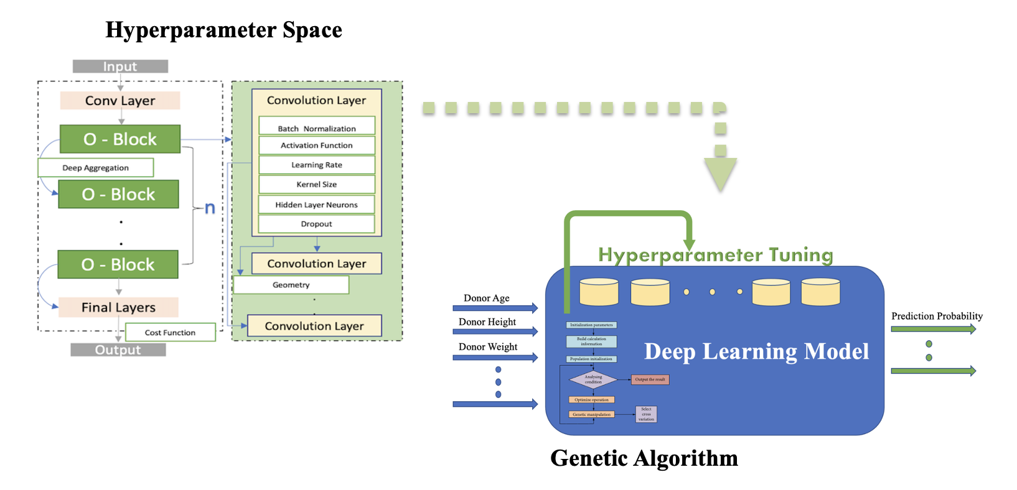
AI-Model Development
Genetic Algorithm for AI model tuning

Slide 14
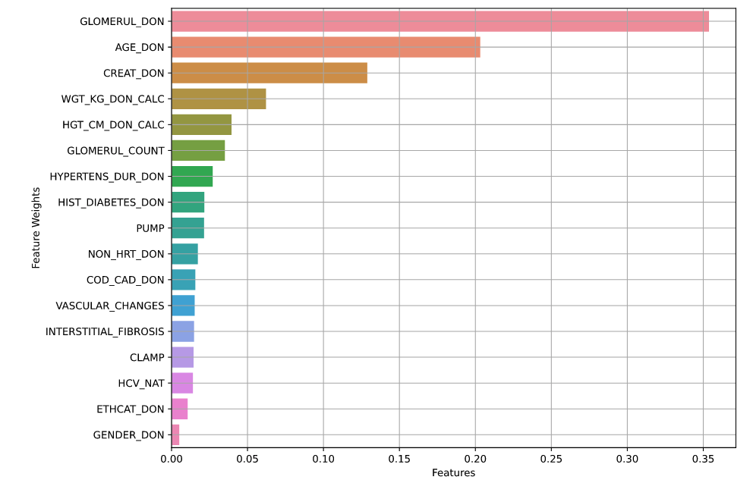
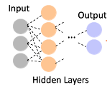
AI Models to Support Decision-Making Process
Hard-to-Place Model
Deceased Donor Characteristics Only
Identify if the kidney is difficult to place
Present offers to out-of-sequence centers
Reduce cold ischemic time, which further reduces kidney quality
Identify transplant centers willing to accept a high-risk kidney and increase utilization of such kidneys
KI_DISPOSITION

Slide 15
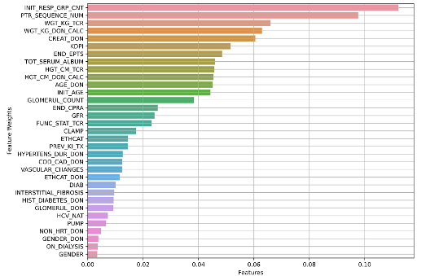
AI Models to Support Decision-Making Process
Deceased Donor and Candidate Characteristics
Provisional Acceptance Model
Identify the likelihood of provisional acceptance
Identify characteristics that may sway acceptance decision
Identify the likelihood of acceptance given current conditions (CIT, SEQ_NUM, KDPI, etc.)
Increase kidney utilization
INITIAL_RESPONSE

Slide 16
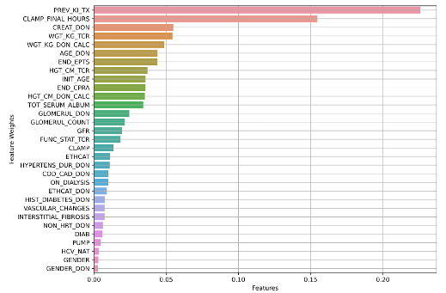
AI Models to Support Decision-Making Process
Deceased Donor and Candidate Characteristics
Primary Acceptance Model
Identify the likelihood of kidney acceptance
Identify characteristics that may sway acceptance decision
Identify the likelihood of acceptance given current conditions (CIT, SEQ_NUM, KDPI, etc.)
Use as a suggestive model to facilitate decision-making
Improves the speed and efficiency of decision-making process
OFFER_ACCEPT

Slide 17
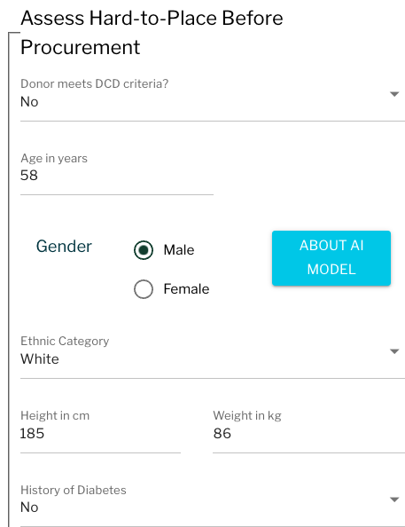
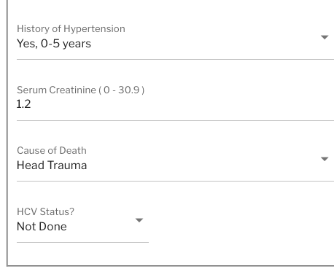
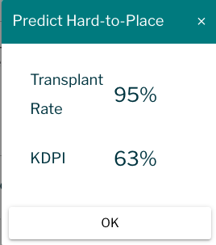
AI-Use Case and Discussion
Before the kidney is procured
https://ddoa.mst.hekademeia.org/#/
Donor
The donor is a white male, 58 years old. He is 185 cm tall and weighs 86 kg. No history of diabetes. History of hypertension is 0-5 years, and a serum creatinine of 1.2. He was not a DCD donor, died of head trauma, and was not tested for hepatitis C.
The kidney is considered mid-quality, KDPI=63.
The chance of this kidney being transplanted is 95% using characteristics available before procurement.
Ashiku L, Dagli C. Identify Hard-to-Place Kidneys for Early Engagement in Accelerated Placement With a Deep Learning Optimization Approach. Transplant Proc. 2023 Jan-Feb;55(1):38-48. doi: 10.1016/j.transproceed.2022.12.005. Epub 2023 Jan 12. PMID: 36641350.

Slide 18
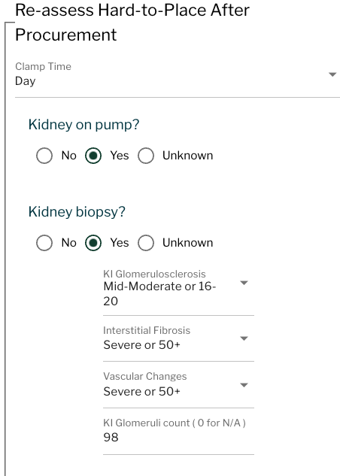
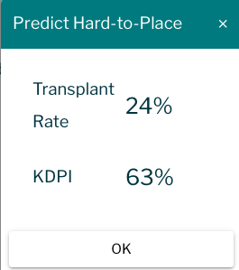
AI-Use Case and Discussion
Biopsy Results are added
https://ddoa.mst.hekademeia.org/#/
Donor
Although a mid-quality deceased donor kidney, the biopsy results show that the kidney has an increased scarring and severe accumulation of collagen and scaffolding. The longer the kidney is out of the body, the more deterioration; therefore, it may justify jumping the list. The kidney may improve the quality of life for candidates with comorbidity who are more likely to die of other diseases.
The donor is a white male, 58 years old. He is 185 cm tall and weighs 86 kg. No history of diabetes. History of hypertension is 0-5 years, and a serum creatinine of 1.2. He was not a DCD donor, died of head trauma, and was not tested for hepatitis C.
The kidney is considered mid-quality, KDPI=63.
The chance of this kidney being transplanted is now 24%.
Ashiku L, Dagli C. Identify Hard-to-Place Kidneys for Early Engagement in Accelerated Placement With a Deep Learning Optimization Approach. Transplant Proc. 2023 Jan-Feb;55(1):38-48. doi: 10.1016/j.transproceed.2022.12.005. Epub 2023 Jan 12. PMID: 36641350.

Slide 19
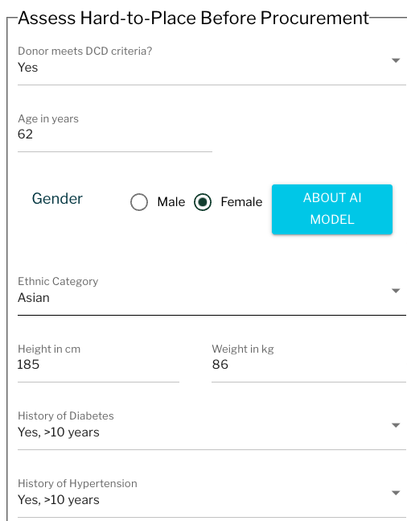
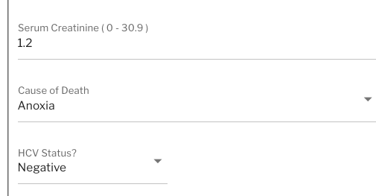
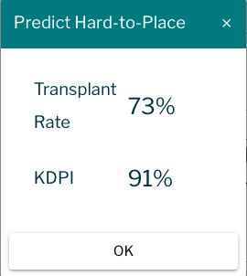
AI-Use Case and Discussion
Before the kidney is procured
https://ddoa.mst.hekademeia.org/#/
Donor
The donor is a 62-year-old Asian female. She is 185 cm tall and weighs 86 kg. History of diabetes and hypertension are both > 10 years. Her serum creatinine is 1.2. She is a DCD donor and died of Anoxia. She was negative for hepatitis C.
The kidney is considered high risk, KDPI=91.
The chance of this kidney being transplanted is 73%, using characteristics available before procurement.
Ashiku L, Dagli C. Identify Hard-to-Place Kidneys for Early Engagement in Accelerated Placement With a Deep Learning Optimization Approach. Transplant Proc. 2023 Jan-Feb;55(1):38-48. doi: 10.1016/j.transproceed.2022.12.005. Epub 2023 Jan 12. PMID: 36641350.

Slide 20
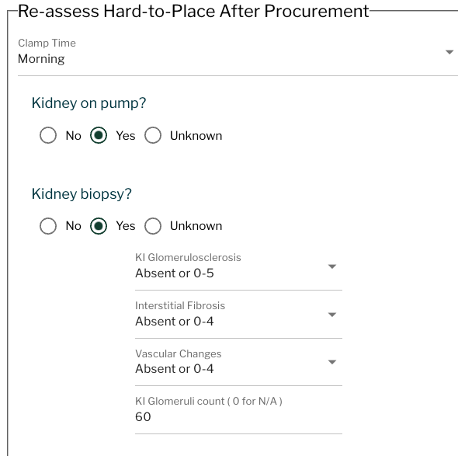
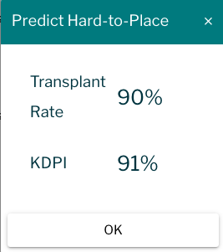
AI-Use Case and Discussion
Biopsy Results are added
https://ddoa.mst.hekademeia.org/#/
Donor
In this high-risk deceased donor kidney, the biopsy indicates that the kidney has minimal scarring and absent accumulation of collagen and scaffolding. The biopsy results have increased the likelihood of a kidney transplant and show that the kidney may be a good fit for a range of candidates.
The donor is a 62-year-old Asian female. She is 185 cm tall and weighs 86 kg. History of diabetes and hypertension are both > 10 years. Her serum creatinine is 1.2. She is a DCD donor and died of Anoxia. She was negative for hepatitis C.
The kidney is considered high risk, KDPI=91.
The chance of this kidney being transplanted is now 91%.
Ashiku L, Dagli C. Identify Hard-to-Place Kidneys for Early Engagement in Accelerated Placement With a Deep Learning Optimization Approach. Transplant Proc. 2023 Jan-Feb;55(1):38-48. doi: 10.1016/j.transproceed.2022.12.005. Epub 2023 Jan 12. PMID: 36641350.

Slide 21
Questions and Feedback
Ashiku L, Dagli C. Identify Hard-to-Place Kidneys for Early Engagement in Accelerated Placement With a Deep Learning Optimization Approach. Transplant Proc. 2023 Jan-Feb;55(1):38-48. doi: 10.1016/j.transproceed.2022.12.005. Epub 2023 Jan 12. PMID: 36641350.

