Slide 1
Project Management:
Standard vs Global
Joan Schuman, Ph.D, PMP
Teaching Professor and Associate Chair
Engineering Management and Systems Engineering
March 18th 2024

Slide 2
Project Management Certificate
Four Courses
Eng Mgt 5320 Project Management
Eng Mgt 5210 Economic Decision Analysis
Eng Mgt 6322 Case Studies in PM
Eng Mgt 6323 Global Project Mgt
This certificate can be stacked with certificates or classes for a MS in Engineering Management
30 credit hours total
https://emse.mst.edu/
https://emse.mst.edu/academicprograms/engineeringmanagement/graduate/

Slide 3
Global Project Management

Slide 4
Global Project Management
Advantages
Penetration of new markets and increased sales
Access to human resources
Lower cost of operations
Economies of scale or strength in size

Slide 5
Global Project Management
Disadvantages
Local people benefit disportionately
Fewer environmental regulations in emerging economies
Ethical inconsistencies

Slide 6
Global Project Management
Culture
I think of icebergs and onions:

Slide 7
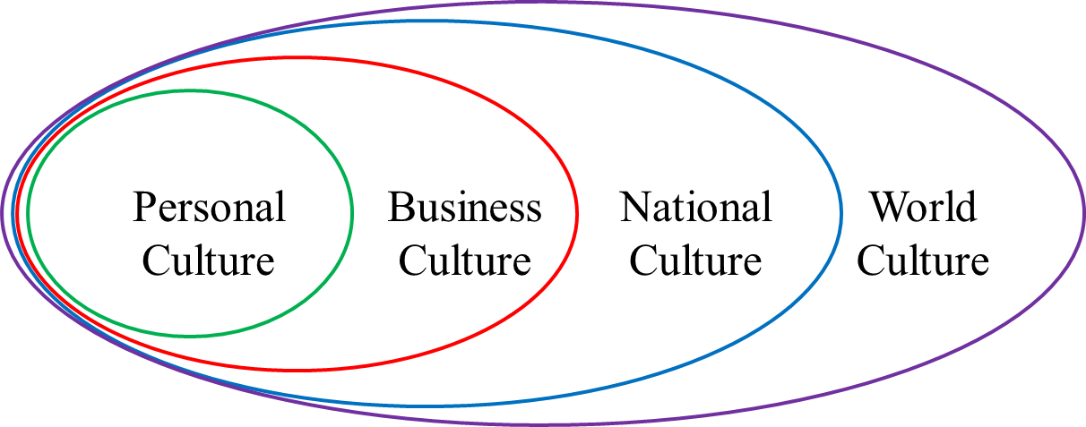
Global Project Management
Culture
Cultural layers for global projects

Slide 8
Global Project Management
Cultural Dimensions - Geert Hofstede https://www.hofstede-insights.com/country-comparison-tool?countries=china%2Cdenmark%2Cmexico%2Cunited+states

Slide 9
Global Project Management
Question
What issues do you see for a project manager who is managing a team with members from Denmark and Mexico?

Slide 10
Global Project Management
Communication
Communicating using diverse languages or dialects
Slower
Less creativity
Misjudgements of resources
Difficulty with technical language

Slide 11
Global Project Management
Low and high context communication
Low context
Explicit
Direct
Succinct
High context
Implicit
Indirect
Elaborate

Slide 12
Global Project Management
Time differences
Most communication on global projects happen asynchronously
Often only a few hours a week are available for synchronous communication
If the communication is not clear initially (there are questions or misunderstanding), it often takes another day
Synchronous communication in most cases should be used for decision making

Slide 13
Global Project Management
Legal considerations
Laws in many countries have evolved from religious practices
Project managers need to understand the laws within the country in which they are working
They must also understand the laws that govern the contract

Slide 14
Global Project Management

